Slide 1
UEL CAC June 21, 2021 Public Meeting at 6:30pm

Slide 2
Call the meeting to order Open public Session

Slide 3
Approval of Agenda

Slide 4
Approval of the Minutes dated May 17, 2021

Slide 5
Electoral Area A Director - Jen MCCutcheon

Slide 6
UEL Manager report to the CAC
Approval of DP8 5537 Chancellor Blvd
Second cannabis retail application is being processed – Atheneum Cannabis planuel@gov.bc.ca

Slide 7
CAC Business
CAC Bank balance as of June 21, 2021
Approval of continued use of bank card for ongoing payments automatic that can not use a cheque or auto debit – Moony moves for approval, Teddy seconds the motion, Moony, Teddy, Patricia voted – Rolf and Vanessa not here

Slide 8
Advisory Design Panel (ADP) - Consideration of ADP appointments - in camera
ADP Update – Patricia
Cannabis
Vanessa and Rolf not present

Slide 9
Area D Plan
Written comments about this application will be accepted by the UEL Manager up to and no later than 4:00 pm on July 8th, 2021. Email submissions may be sent to planUEL@gov.bc.ca; uelcac@gmail.com; areaajen@gmail.com. All comments form part of the public record and copies of the comments will be provided to the applicant. Please note that for non-medical cannabis retail licence applications in the UEL, Metro Vancouver Regional District (MVRD) must gather residents’ views to make comments and recommendations on the licensee’s application to the BC Liquor and Cannabis Regulation Branch (LCRB). Written comments submitted as part of this rezoning application will be considered as gathering residents’ views for the MVRD and will be used to inform MVRD comments and recommendations to the BC LCRB.

Slide 10
Community Works Fund
Update
Survey Monkey

Slide 11
Community Concerns
Cannabis Retail
Unsightly properties - “UEL bylaw 57 (2) (c), in our area, a single family dwelling may not keep more than 2 roomers, boarders or lodgers.” - 5770 Chancellor Boulevard.- images 10 + numbered bedrooms, wires hanging, plumbing issues, code violations -to be held
Unkempt Neighbourhood yards - not maintaining their front yards and allowing the grass to grow without being mowed and maintained.
Non-compliant fences

Slide 12
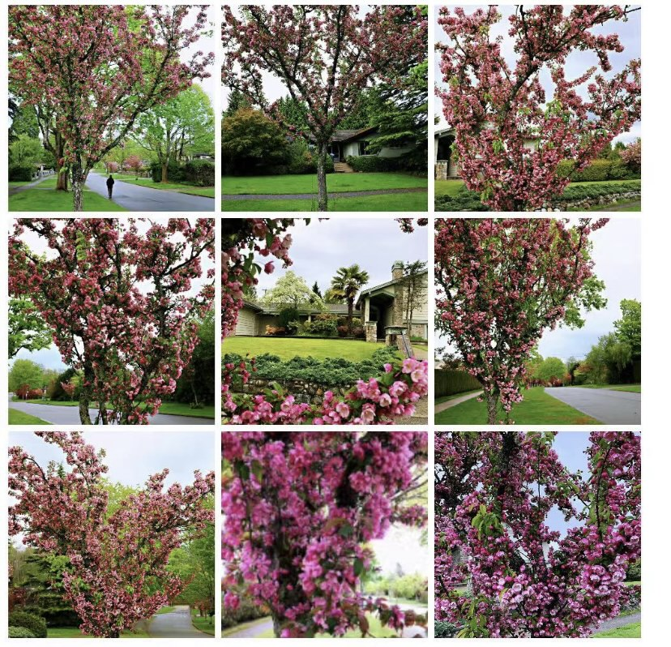
Crab-Apple Flower Trees cut in Area A - and it appears that no explanations/notices were given - these appear to be separate matter from the trees on Wesbrook Crescent

Slide 13
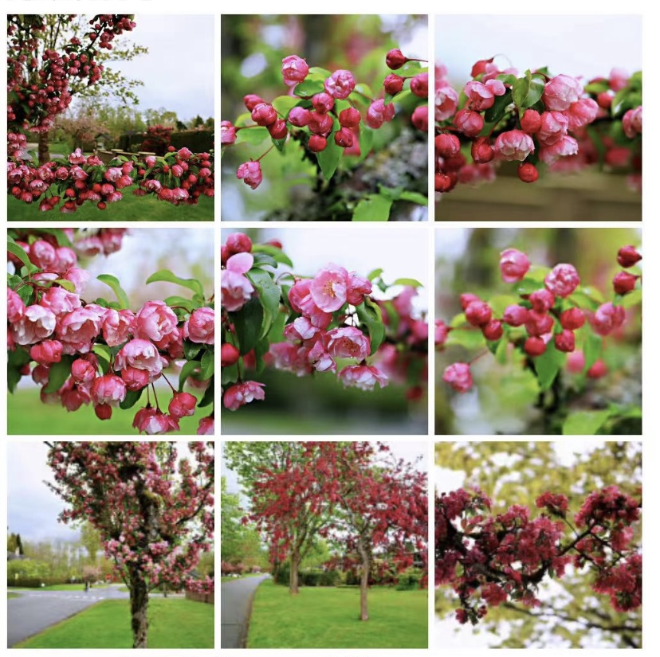

Slide 14
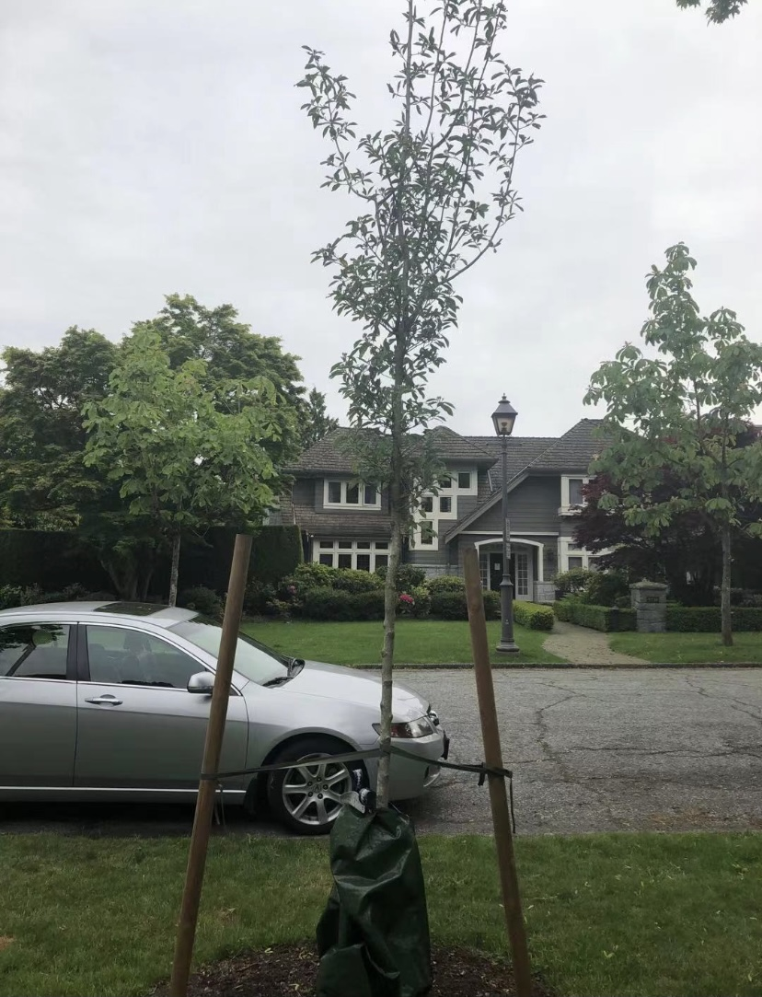

Slide 15
A few neighbours asked about putting up a stop sign at the bike path that is on Chancellor Blvd (it is an asphalt path in Area C - very dangerous because bikes and cars don’t stop, there is a hedge that obstructs the view - can cause accidents to pedestrians or other users of the road (Teddy)
Kings road - poor signage, people drive on the wrong side (opposite side) of the road when it is a one way road (should also have children sign because there are children) (Patricia)

Slide 16
Follow-Ups
Trees - to be held over
Bike Storage - to be held over
Muddy Area on Dalhousie Rd. - Cressy - to be held oer
Letter regarding air-conditioning unit -to be held over

Slide 17
Questions and Comments from the Public to the CAC
Leaf blower – electric? (noise)
Jen McCutcheon – invite timely
Independent arborist
Enforcing bylaw of lawn maintenance
Next Meeting
Adjournment

